Slide 1
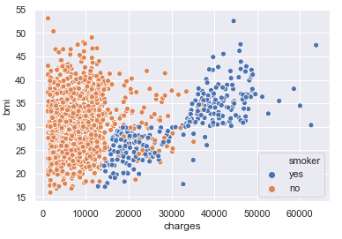
Project 2 - Business Statistics - Axis Insurance; EDA and Hypothesis Testing with Statistic Analysis
Barry Pratt
Post Graduate Program - Data Science and Business Analytics, McCombs Business School, UoT at Austin, with Great Learning
March 19, 2021

Slide 2
Background and Objectives
Axis Insurance; Statistical Analysis of Business Data – get comfortable with doing Statistical Analysis in Python.
Using EDA/Graphical exploration we will investigate the dataset and gain some insights and observations.
We will further provide 4 Statistic tests on the Business Data to inform choices needed at Axis Insurance .
If/when the business implements a recommendation, a new analysis can be run to verify the success/failure of the change.

Slide 3
Data Information for our work
Data | Description
Age | Integer indicating age of primary beneficiary/policy holder (excluding > 64)
Sex* | The policy holders' gender, male or female
BMI | The body mass index (BMI) of policy holder
Children | Integer, number of children covered by insurance plan
Smoker* | Yes or no if insured regularly smokes tobacco
Region* | This is the beneficiary’s/policy holder's region; northeast, southeast, southwest, or northeast
Charges | Individual medical costs billed to insurance company
Observations | Variables | Duration
1338 | 7 | N/A
Note:
Asterisk (*) denotes variables that were ‘objects’ and required pre-processing to be converted to dtype ‘category.’
However, there were no missing values to impute or process.

Slide 4
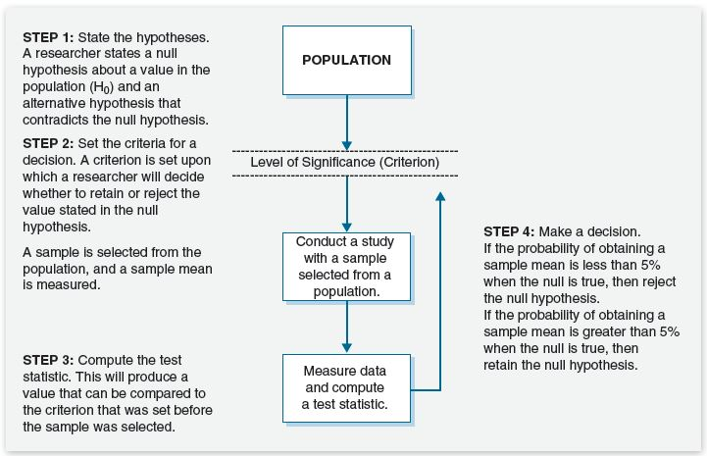
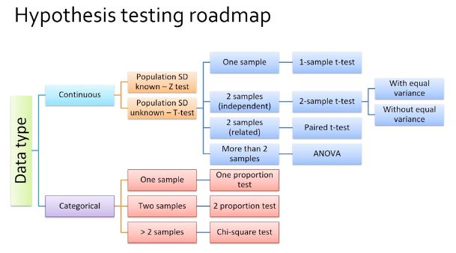
Key charts for our Hypothesis testing
The Hypothesis Testing Roadmap aids us to select the right Statistic test that fits the datatype, known or unknown SD, the numbers of samples and test types that can be employed. Source – Great Learning Course Shell.
The summary of Hypothesis Testing helps us define the necessary steps from Hypothesis H0 and Ha formulation, the criteria/significance level, selecting the test, and making the decision to reject or fail to reject the Null Hypothesis. Source - https://www.sagepub.com/sites/default/files/upm-binaries/40007_Chapter8.pdf

Slide 5
Axis Insurance Questions to Answer
The presentation is expected to provide the following:
1/ Explore the dataset and extract insights using Exploratory Data Analysis.
2/ Prove (or disprove) that the medical claims made by the people who smoke is greater than those who don't? [Hint- Formulate a hypothesis and prove/disprove it]
3/ Prove (or disprove) with statistical evidence that the BMI of females is different from that of males.
4/ Is the proportion of smokers significantly different across different regions? [Hint : Create a contingency table/cross tab, Use the function : stats.chi2_contingency()]
5/ Is the mean BMI of women with no children, one child, and two children the same? Explain your answer with statistical evidence.
*Consider a significance level of 0.05 for all tests.

Slide 6
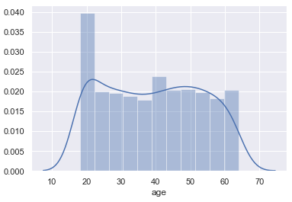
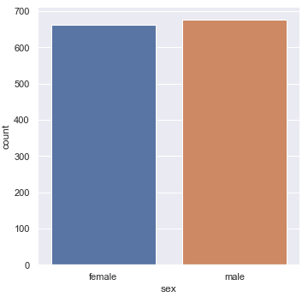
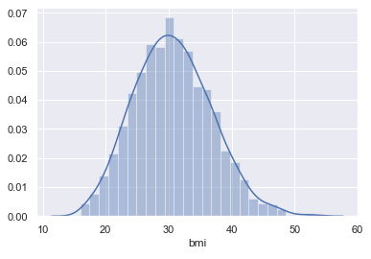
Axis Insurance EDA – Preliminary Univariate Analysis, Age, Sex, BMI
Our policy holders have a mean age of 39.2 years, a median of 39, with a range of 18 to 64 years. We have an IQR of 24 and sample ‘std’ of 14.1. A peak when people enter the plan at 18, but the rest of the distribution up to 64 is more 'uniform' in nature; shapiro test – ‘not’ normal.
The BMI of our 1338 policy holders has a mean of 30.66, a median of 30.40, and a range of 15.96 to 53.13. We have ‘std’ of 6.10. The 'bmi' is a continuous variable and appears more 'normally' distributed, but with a higher peak
Of a total sample size of 1338, there are 676 males and 662 females, almost a balanced categorial sample.
Notes:
Product Lifecycle
We are still in the nascent period of the real Blockchain product market, however, our lead course is already in the Growth/Persuasive Advertising portion of its lifecycle, and requires continuous and diligent revising and updates to stay current and valuable. The sector is moving fast, and the long-term need for our courses will change. We will need to evolve with the market and possibly pivot into new areas, adjacent to our advisors' space.
We have already foreseen the requirement to create new courses that will create overlapping and scalloped summed growth curves, a nice problem to have. While we will stretch our initial courses by continuous editing and improvements, the time to have new courses ready will be soon upon us.
Not our key problem, but a sub-problem, is also the work that will be required to segment and refocus our existing products to reach new professionals who are more interested in the Legal, Policy and Governance aspects of Blockchain Technology, perhaps also with visions of creating an Initial Coin Offering (ICO), which should be called Initial Token Offering (ITO). (Rosic, M. 2016). Our product needs to be expanded into new courses in the specific areas of Legal, Policy and Governance using blockchain/DLT technologies. While we will be using Advisors who have credentials of an accredited Lawyer, Certified/chartered Public Account, or similar, we will need to be very careful on disclosure, that we are not supplying securities advise . One of our advisors and trainers has a formal relationship with the Ontario Securities Commission (OSC), so this will be clarified as we develop new product. I was actually at a Blockchain Hack-a-thon, that was run and supported by the OSC, to investigate the technology at ground level. They are very forward looking and want to guide and protect Canadian (and other) investors in my local space.
The creation of new products to answer to new persona's will be critical to our long term success.
For example, if we were to train a CIO in our initial courses and get them "certified", they won't be certified again; in effect, we have a good ambassador of your brand, however, the same customer is only a customer again, if you have further courses, like the Legal, Policy, Governance course, or create technical developer and programmer courses in blockchain technology, like Ethereum/Solidity/Smart Contract programming, or Hyperledger integration, so that CIO can send his programming and development staff to be trained. (Ethereum Project, nd; Hyperledger Project, 2016)
Without having this portfolio of courses to offer, getting that CxO or VP once, and then not having another course for them, of for their staff, the LTV is low, or stops after the first course, does it not? (Kotler and Keller, ch. 4)
We'll also be doing an Blockchain Architecture course that will appeal to a new segmentation, that of the Enterprise Architect, however that won't be available until later this year.
Reference
Ethereum Project; see https://www.ethereum.org/
Hyperledger Project; see https://www.hyperledger.org/
Kotler, P., Keller, K. 2016. A Framework For Marketing Management, 6th Ed. Pearson Education Limited.
Rosic, M. 2016. What is an ICO? Raising Millions in Seconds. Retrieved from https://blockgeeks.com/guides/initial-coin-offering/
Transformationworx. (2018). Retrieved from https://www.transformationworx.com/
Transformationworx, Board of Advisors. (2018). Retrieved from https://www.transformationworx.com/board-of-advisors
Week 2 Lecture 1 and Lecture 2 Notes.

Slide 7
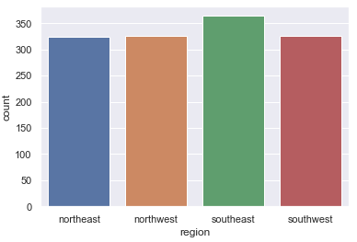
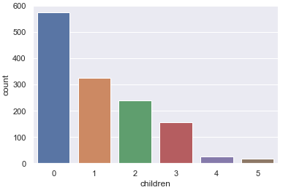
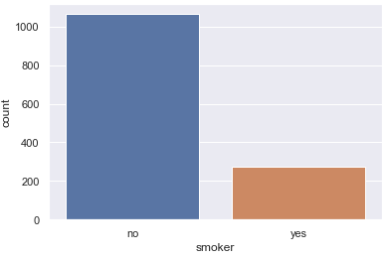
Axis Insurance EDA – Preliminary Univariate Analysis, Children, Smoker, Region
In 1338 policy holders, 574 have no children, 324 have 1 child, 240 have 2 children, 157 have 3 children, 25 have 4 children, and 18 have 5 children. The mean number of children per policy holder is 1.09, median of 1.00, IQR of 2, ‘std’ of 1.20, and of course, a range of 5, but 6 values.
Of 1338 policy holders, 1024 do not smoke, and 274 do smoke.
In the 1338 lines, the region counts are reasonably equal with southeast a little higher with 364, but southwest, northwest and northeast with 325, 325 and 324 respectively.
Notes:
Product Lifecycle
We are still in the nascent period of the real Blockchain product market, however, our lead course is already in the Growth/Persuasive Advertising portion of its lifecycle, and requires continuous and diligent revising and updates to stay current and valuable. The sector is moving fast, and the long-term need for our courses will change. We will need to evolve with the market and possibly pivot into new areas, adjacent to our advisors' space.
We have already foreseen the requirement to create new courses that will create overlapping and scalloped summed growth curves, a nice problem to have. While we will stretch our initial courses by continuous editing and improvements, the time to have new courses ready will be soon upon us.
Not our key problem, but a sub-problem, is also the work that will be required to segment and refocus our existing products to reach new professionals who are more interested in the Legal, Policy and Governance aspects of Blockchain Technology, perhaps also with visions of creating an Initial Coin Offering (ICO), which should be called Initial Token Offering (ITO). (Rosic, M. 2016). Our product needs to be expanded into new courses in the specific areas of Legal, Policy and Governance using blockchain/DLT technologies. While we will be using Advisors who have credentials of an accredited Lawyer, Certified/chartered Public Account, or similar, we will need to be very careful on disclosure, that we are not supplying securities advise . One of our advisors and trainers has a formal relationship with the Ontario Securities Commission (OSC), so this will be clarified as we develop new product. I was actually at a Blockchain Hack-a-thon, that was run and supported by the OSC, to investigate the technology at ground level. They are very forward looking and want to guide and protect Canadian (and other) investors in my local space.
The creation of new products to answer to new persona's will be critical to our long term success.
For example, if we were to train a CIO in our initial courses and get them "certified", they won't be certified again; in effect, we have a good ambassador of your brand, however, the same customer is only a customer again, if you have further courses, like the Legal, Policy, Governance course, or create technical developer and programmer courses in blockchain technology, like Ethereum/Solidity/Smart Contract programming, or Hyperledger integration, so that CIO can send his programming and development staff to be trained. (Ethereum Project, nd; Hyperledger Project, 2016)
Without having this portfolio of courses to offer, getting that CxO or VP once, and then not having another course for them, of for their staff, the LTV is low, or stops after the first course, does it not? (Kotler and Keller, ch. 4)
We'll also be doing an Blockchain Architecture course that will appeal to a new segmentation, that of the Enterprise Architect, however that won't be available until later this year.
Reference
Ethereum Project; see https://www.ethereum.org/
Hyperledger Project; see https://www.hyperledger.org/
Kotler, P., Keller, K. 2016. A Framework For Marketing Management, 6th Ed. Pearson Education Limited.
Rosic, M. 2016. What is an ICO? Raising Millions in Seconds. Retrieved from https://blockgeeks.com/guides/initial-coin-offering/
Transformationworx. (2018). Retrieved from https://www.transformationworx.com/
Transformationworx, Board of Advisors. (2018). Retrieved from https://www.transformationworx.com/board-of-advisors
Week 2 Lecture 1 and Lecture 2 Notes.

Slide 8
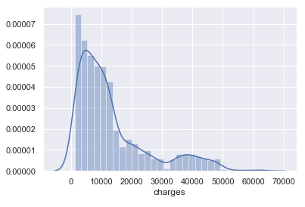
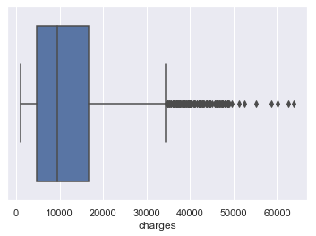
Exploratory Data Analysis – Preliminary Univariate Analysis, Charges
The variable 'charges' is more right-skewed at a skew value of 1.515, we'll investigate outliers to the right. With a sample mean of 13270 and median of 9382, std of 12110, we genuinely see the extent of the outliers in charges past the whisker at 1.5*IQR, IQR = 11899.62, range from 1121.87 to 63770.43.
There are a significant number of outliers in 'charges,' and these could be of interest to an insurance company to mitigate and/or set the fees for policy holders on 'age,' 'sex,' 'smoking,' and perhaps 'bmi.'
Notes:
Product Lifecycle
We are still in the nascent period of the real Blockchain product market, however, our lead course is already in the Growth/Persuasive Advertising portion of its lifecycle, and requires continuous and diligent revising and updates to stay current and valuable. The sector is moving fast, and the long-term need for our courses will change. We will need to evolve with the market and possibly pivot into new areas, adjacent to our advisors' space.
We have already foreseen the requirement to create new courses that will create overlapping and scalloped summed growth curves, a nice problem to have. While we will stretch our initial courses by continuous editing and improvements, the time to have new courses ready will be soon upon us.
Not our key problem, but a sub-problem, is also the work that will be required to segment and refocus our existing products to reach new professionals who are more interested in the Legal, Policy and Governance aspects of Blockchain Technology, perhaps also with visions of creating an Initial Coin Offering (ICO), which should be called Initial Token Offering (ITO). (Rosic, M. 2016). Our product needs to be expanded into new courses in the specific areas of Legal, Policy and Governance using blockchain/DLT technologies. While we will be using Advisors who have credentials of an accredited Lawyer, Certified/chartered Public Account, or similar, we will need to be very careful on disclosure, that we are not supplying securities advise . One of our advisors and trainers has a formal relationship with the Ontario Securities Commission (OSC), so this will be clarified as we develop new product. I was actually at a Blockchain Hack-a-thon, that was run and supported by the OSC, to investigate the technology at ground level. They are very forward looking and want to guide and protect Canadian (and other) investors in my local space.
The creation of new products to answer to new persona's will be critical to our long term success.
For example, if we were to train a CIO in our initial courses and get them "certified", they won't be certified again; in effect, we have a good ambassador of your brand, however, the same customer is only a customer again, if you have further courses, like the Legal, Policy, Governance course, or create technical developer and programmer courses in blockchain technology, like Ethereum/Solidity/Smart Contract programming, or Hyperledger integration, so that CIO can send his programming and development staff to be trained. (Ethereum Project, nd; Hyperledger Project, 2016)
Without having this portfolio of courses to offer, getting that CxO or VP once, and then not having another course for them, of for their staff, the LTV is low, or stops after the first course, does it not? (Kotler and Keller, ch. 4)
We'll also be doing an Blockchain Architecture course that will appeal to a new segmentation, that of the Enterprise Architect, however that won't be available until later this year.
Reference
Ethereum Project; see https://www.ethereum.org/
Hyperledger Project; see https://www.hyperledger.org/
Kotler, P., Keller, K. 2016. A Framework For Marketing Management, 6th Ed. Pearson Education Limited.
Rosic, M. 2016. What is an ICO? Raising Millions in Seconds. Retrieved from https://blockgeeks.com/guides/initial-coin-offering/
Transformationworx. (2018). Retrieved from https://www.transformationworx.com/
Transformationworx, Board of Advisors. (2018). Retrieved from https://www.transformationworx.com/board-of-advisors
Week 2 Lecture 1 and Lecture 2 Notes.

Slide 9
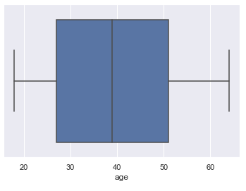
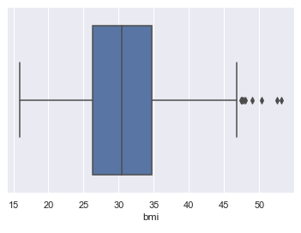
Exploratory Data Analysis – Preliminary Univariate Analysis, Further Outlier Analysis.
As expected, we have no outliers beyond the 'whiskers,’ mean of 39.20, Q1 at 27, median at 39 and Q3 at 51, IQR=24, min=18 and max=64, given insurance policy entrance age and excluding >64.
We have several outliers above the 1.5*IQR, with a maximum of 53.13 body mass index. If the ideal BMI is between 18.5 to 24.9, then this boxplot 'graphically' shows a very obese sample of the population - or if indicative of the population, then weight loss and daily exercise is required. (IMHO)
Notes:
Product Lifecycle
We are still in the nascent period of the real Blockchain product market, however, our lead course is already in the Growth/Persuasive Advertising portion of its lifecycle, and requires continuous and diligent revising and updates to stay current and valuable. The sector is moving fast, and the long-term need for our courses will change. We will need to evolve with the market and possibly pivot into new areas, adjacent to our advisors' space.
We have already foreseen the requirement to create new courses that will create overlapping and scalloped summed growth curves, a nice problem to have. While we will stretch our initial courses by continuous editing and improvements, the time to have new courses ready will be soon upon us.
Not our key problem, but a sub-problem, is also the work that will be required to segment and refocus our existing products to reach new professionals who are more interested in the Legal, Policy and Governance aspects of Blockchain Technology, perhaps also with visions of creating an Initial Coin Offering (ICO), which should be called Initial Token Offering (ITO). (Rosic, M. 2016). Our product needs to be expanded into new courses in the specific areas of Legal, Policy and Governance using blockchain/DLT technologies. While we will be using Advisors who have credentials of an accredited Lawyer, Certified/chartered Public Account, or similar, we will need to be very careful on disclosure, that we are not supplying securities advise . One of our advisors and trainers has a formal relationship with the Ontario Securities Commission (OSC), so this will be clarified as we develop new product. I was actually at a Blockchain Hack-a-thon, that was run and supported by the OSC, to investigate the technology at ground level. They are very forward looking and want to guide and protect Canadian (and other) investors in my local space.
The creation of new products to answer to new persona's will be critical to our long term success.
For example, if we were to train a CIO in our initial courses and get them "certified", they won't be certified again; in effect, we have a good ambassador of your brand, however, the same customer is only a customer again, if you have further courses, like the Legal, Policy, Governance course, or create technical developer and programmer courses in blockchain technology, like Ethereum/Solidity/Smart Contract programming, or Hyperledger integration, so that CIO can send his programming and development staff to be trained. (Ethereum Project, nd; Hyperledger Project, 2016)
Without having this portfolio of courses to offer, getting that CxO or VP once, and then not having another course for them, of for their staff, the LTV is low, or stops after the first course, does it not? (Kotler and Keller, ch. 4)
We'll also be doing an Blockchain Architecture course that will appeal to a new segmentation, that of the Enterprise Architect, however that won't be available until later this year.
Reference
Ethereum Project; see https://www.ethereum.org/
Hyperledger Project; see https://www.hyperledger.org/
Kotler, P., Keller, K. 2016. A Framework For Marketing Management, 6th Ed. Pearson Education Limited.
Rosic, M. 2016. What is an ICO? Raising Millions in Seconds. Retrieved from https://blockgeeks.com/guides/initial-coin-offering/
Transformationworx. (2018). Retrieved from https://www.transformationworx.com/
Transformationworx, Board of Advisors. (2018). Retrieved from https://www.transformationworx.com/board-of-advisors
Week 2 Lecture 1 and Lecture 2 Notes.

Slide 10
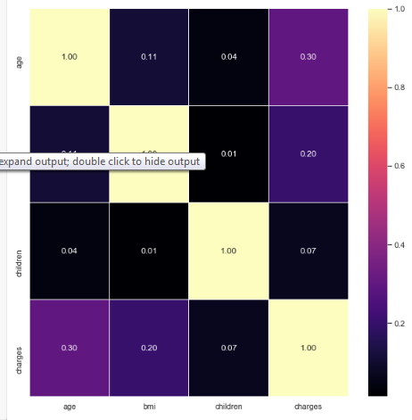
EDA – Heatmap toward Multivariate Analysis
“Correlation does not imply causation,” however, we do have an all-positive heatmap, as one variable increases, the other variable increases.
Only Age with Charges, and BMI with Charges shows a low to moderate correlation of 0.30 and 0.20 respectively, the other pairs are very low.
We will need to investigate Age, Charges and BMI with Sex, Smoker and Region to bring out some insights, help draw possible conclusions and aid the statistic analysis.

Slide 11
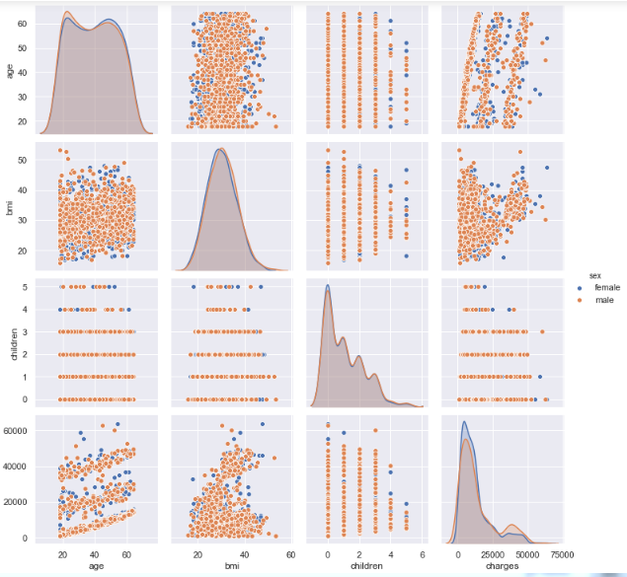
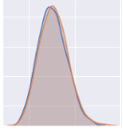
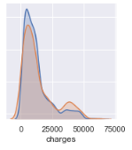
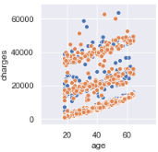

EDA Pairplot with Sex, Males = Orange, Females = Blue
Looking at males and females, of interest to statistical questions, the BMI distribution of females is very similar to that of males. And for Charges, more females' charges are in the lower cost part of the right-skewed distribution, while in the higher cost right-tail, we have more males. We could also look at the "banding" in Charges versus Age.
Notes:
Reference
https://www.transformationworx.com/product-page/cio-peer-forum-blockchain-bootcamp-cio-foundational-certification

Slide 12
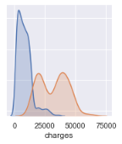
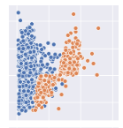
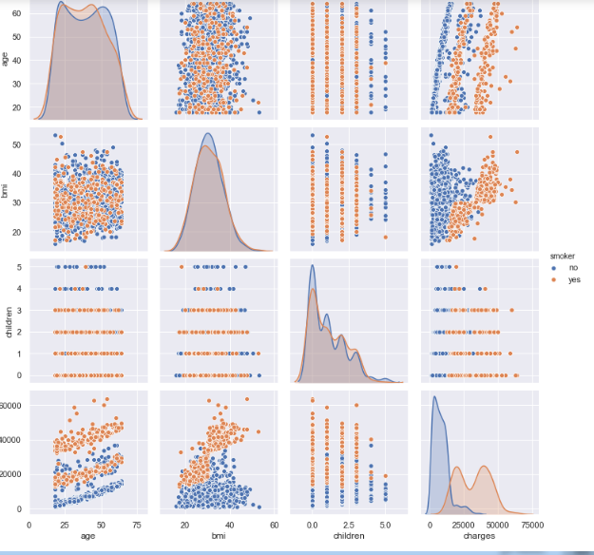
EDA Pairplot with Smoker, Non-smoker = Blue, Smoker = Orange
Of interest to statistical questions, the Charges distribution of non-smokers is very different, the median Charge of non-smokers looks to be much lower than smokers, and the smokers is higher but appears bimodal as well. We'll also investigate BMI and Charges, as the highest 'charges' are all smokers, while there seems to be a significant "cluster" of non-smokers with low to mid-range 'charges'.
Notes:
Reference
https://www.transformationworx.com/product-page/cio-peer-forum-blockchain-bootcamp-cio-foundational-certification

Slide 13
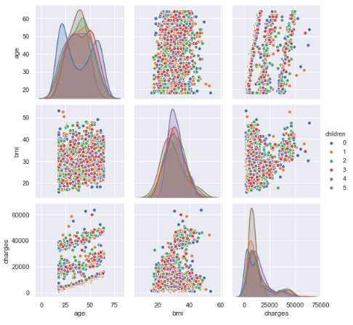
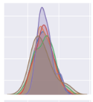

EDA Pairplot with Children, (Legend on Page)
Visually, the mean BMI of (females and males) with no children, one child and two children looks similar and may be statistically the same? We'll need to look at that in the statistics section.
Notes:
Reference
https://www.transformationworx.com/product-page/cio-peer-forum-blockchain-bootcamp-cio-foundational-certification

Slide 14
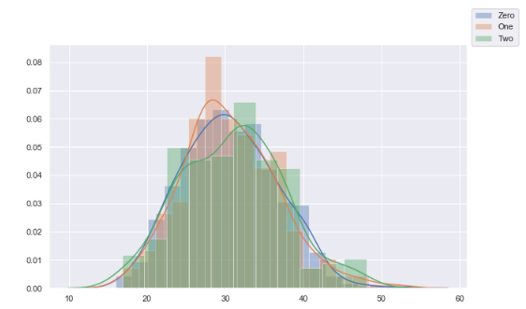
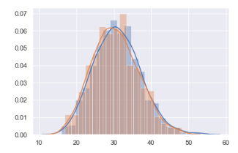
EDA – Distribution of BMI for 0, 1, and 2 children, Distribution of BMI for Males and Females
BMI
BMI
For the mean BMI's of (males and females) with zero, one or two children, they are similar, but we'll need to extract woman only in the statistics section. For completeness, we'll visually compare BMI of males and females to the right.
It appears that the BMI distributions of males and females is quite similar and may be statistically the same; we test that in the questions.
Notes:
Reference
https://www.transformationworx.com/product-page/cio-peer-forum-blockchain-bootcamp-cio-foundational-certification

Slide 15
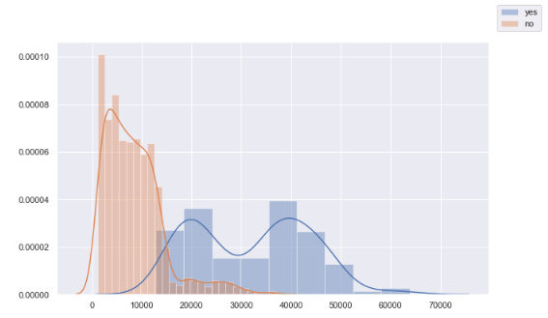
EDA – Are the insurance charges greater for those who Smoke? Non-smoker = Orange, Smoker = Blue
Now we can more clearly see, the 'charges' distribution of non-smokers is very different, the median 'charge' of non-smokers looks to be much lower than smokers, and the smokers is much higher but also appears to be bimodal.
Charges
Notes:
Reference
https://www.transformationworx.com/product-page/cio-peer-forum-blockchain-bootcamp-cio-foundational-certification

Slide 16
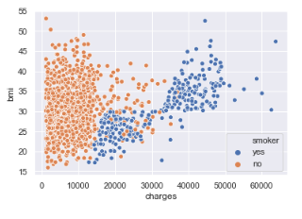
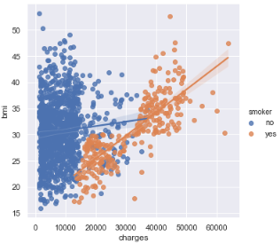
EDA – Looking further at Smoking with BMI and Charges
The 'lmplot' gives us regression lines to help us compare. We can see that the Smokers line starts at a minimum of ~12,829, extends to a maximum of ~63,770, but the Smokers line has a much higher "slope" as compared to the Non-smoker line. The Non-smoker line starts at ~1,121 and only extends to ~36,910. While the number of Smokers is less, the extra charges above the Non-smokers is ~26,860 - these numbers, plus other analytic and statistic functions should be of concern for an insurance company and help inform a higher rate for smokers.
This scatterplot clearly shows key relationships for much higher Charges for people who have moderate to high BMI but are smokers! And it demonstrates that the outlier distribution of the highest 'charges' are clearly also from those who smoke.
Notes:
Reference
https://www.transformationworx.com/product-page/cio-peer-forum-blockchain-bootcamp-cio-foundational-certification

Slide 17
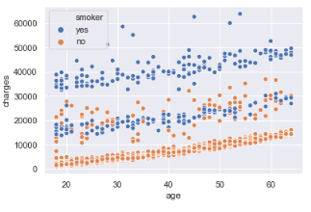
EDA – Investigating Age with Charges and Smoking Non-smoker = Orange, Smoker = Blue
Yes, as expected Charges goes up with Age, but the banding is fascinating! The lower band is all non-smokers, the mid-band is the mix of smokers and non-smokers with more variability in the non-smokers, while the top band with the highest charges, are, of course, smokers. The highest charges (outliers) for Smokers across the ages are clearly visible.
Charges
Notes:
Reference
https://www.transformationworx.com/product-page/cio-peer-forum-blockchain-bootcamp-cio-foundational-certification

Slide 18
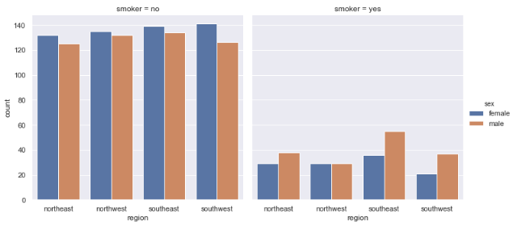
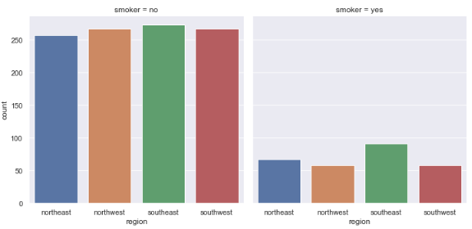
EDA - Looking further for Smoker by Region
From a proportionality point of view, visually, there seems to be much more 'proportional' variability across regions for smokers than non-smokers, and more male smokers than female, despite the overall proportional difference of non-smokers 1064/1338 to smokers 274/1338. We'll need to review this in the statistics testing section.
Notes:
Reference
https://www.transformationworx.com/product-page/cio-peer-forum-blockchain-bootcamp-cio-foundational-certification

Slide 19
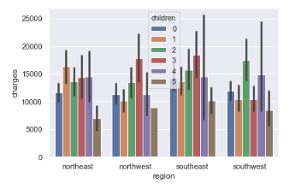
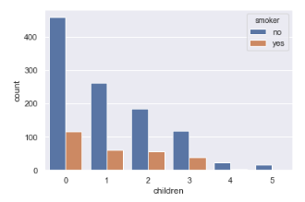
EDA - A quick look at Children by Region and Charges, Number of Children of Non-Smoker or Smoker
Given the error bars, the charges by number of children of each policy holder could be similar across the regions, and some statistical testing could confirm more insights. The number of children per policy holder that are non-smokers or smokers may be the non-smokers 1064/1338 to smokers 274/1338 ratio, but again, a statistical test might help us to prove some further insight.
Notes:
Reference
https://www.transformationworx.com/product-page/cio-peer-forum-blockchain-bootcamp-cio-foundational-certification

Slide 20
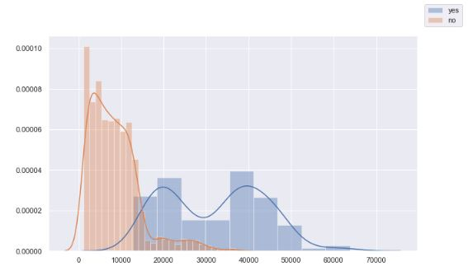
Statistic Proofs asked by Axis Insurance - Question 2
2/ Prove (or disprove) that the medical claims made by people who smoke is greater than those who don't?
Null Hypothesis: H0 = Smoking does not affect Insurance Charges
Alternative Hypothesis: Ha = Smoking does affect Insurance Changes
*Visually in the Multivariate section, we saw the Charges' distribution of non-smokers is very different, the median 'charge' of non-smokers looks to be much lower than smokers, and the smokers is not only much higher, and includes high-cost outliers, but also appears to be bimodal.
*Referring to the Hypothesis Testing Roadmap, we have 'charges' continuous data, 2 samples, choose 2 sample independent t-test. Consider a significance level of 0.05
Notes:
Reference
https://www.transformationworx.com/product-page/cio-peer-forum-blockchain-bootcamp-cio-foundational-certification

Slide 21
Statistic Proofs asked by Axis Insurance – 2 / continued
Our statistic test for this question, at significance level of 0.05 returned;
t_statistic = 46.664921172723716 p_value = 8.271435842177219e-283
Reject Null Hypothesis, Smoking does have an effect on charges
With such a large t_statistic sd, and vanishingly low p_value, we reject the Null Hypothesis.
Therefore, we reject the null hypothesis based on our statistic test and the visualization above, smoking does have an effect on charges.
This information will inform insurance rates for smokers!
Notes:
Reference
https://www.transformationworx.com/product-page/cio-peer-forum-blockchain-bootcamp-cio-foundational-certification

Slide 22
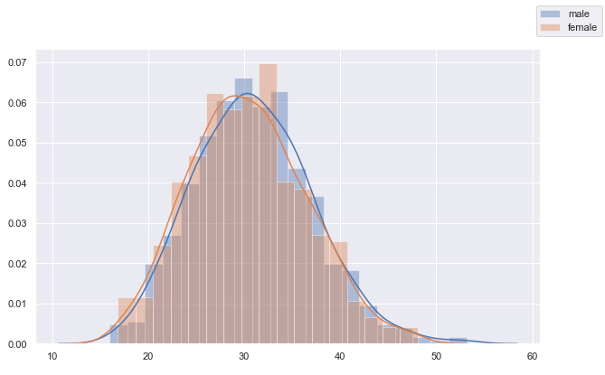
Statistic Proofs asked by Axis Insurance - Question 3
3 / Prove (or disprove) with statistical evidence that the BMI of females is different from that of males?
Null Hypothesis: H0 = The bmi of males is not significantly different than that of females
Alternative Hypothesis: Ha = The bmi of males is different than that of females
*Visually in the Multivariate section above, it appears that the BMI distributions of males and females is quite similar and may be statistically the same.
*Referring to the Hypothesis Testing Roadmap, we have 'bmi' continuous data, 2 samples, choose 2 sample independent t-test. Consider a significance level of 0.05.
Notes:
Reference
https://www.transformationworx.com/product-page/cio-peer-forum-blockchain-bootcamp-cio-foundational-certification

Slide 23
Statistic Proofs asked by Axis Insurance – 3 / continued
Our statistic test for this question, at significance level of 0.05 returned;
t_statistic = 1.696752635752224 p_value = 0.08997637178984932.
While the t_statistic is 1.697 sd away from the expected value, the p_value is compared to significance level of 0.05.
Result: Fail to Reject, or "accept" null hypothesis, sex/gender has no statistical effect on bmi
Therefore, we fail to reject, or business-wise accept the null hypothesis, The bmi of males is not significantly different than that of females
This information will also inform insurance rates for the genders!
Notes:
Reference
https://www.transformationworx.com/product-page/cio-peer-forum-blockchain-bootcamp-cio-foundational-certification

Slide 24

Statistic Proofs asked by Axis Insurance - Question 4
4 / Is the proportion of smokers significantly different across different regions
Null Hypothesis: H0 = The proportion of smokers is not significantly different across different regions¶
Alternative Hypothesis: Ha = The proportion of smokers is significantly different across different regions
*Visually in the Multivariate section above, it appears that the proportion of smokers across the 4 regions looks to have more proportional variability from that of non-smokers despite the overall proportional difference of non-smokers 1064/1338 to smokers 274/1338, however, we'll need to apply a test.
*Referring to the Hypothesis Testing Roadmap, 'smokers' and 'region' are categorical, and we have 4 regions, so we'll need to use the Chi-square test. Consider a significance level of 0.05.
Notes:
Reference
https://www.transformationworx.com/product-page/cio-peer-forum-blockchain-bootcamp-cio-foundational-certification

Slide 25
Statistic Proofs asked by Axis Insurance – 4 / continued
Our statistic test for this question, at significance level of 0.05 returned;
Chisquare = 7.34348, p_value =0.06172, but we calculated a critical value of 7.81473 at a significance of 0.05, p=(1-0.05).
Comparing Chisquare to Critical value returns;
Fail to Reject, or "accept" null hypothesis, the proportion of smokers is not significantly different across different regions.
Therefore, we fail to reject, or business-wise accept the null hypothesis, the proportion of smokers is not significantly different across different regions.
(This information may have little effect on insurance rates for smokers.)
Notes:
Reference
https://www.transformationworx.com/product-page/cio-peer-forum-blockchain-bootcamp-cio-foundational-certification

Slide 26
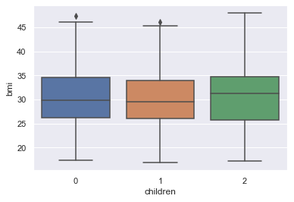
Statistic Proofs asked by Axis Insurance - Question 5
Female only Policy Holders
5 / Is the mean BMI of of woman with no children, one child, and two children the same?
Null Hypothesis: H0 = The mean BMI of of woman with no children, one child, and two children are the same
Alternative Hypothesis: Ha = The mean BMI of of woman with no children, one child, and two children are not the same
*Referring to the Hypothesis Testing Roadmap, 'bmi' is continuous but we have more than 2 samples, so we can use analysis of variance (ANOVA) to determine whether the means are statistically the same (equality of means) or one or more is different.
Visually, given the samples from a population, the BMI distributions and their means look relatively the same when reviewing the Boxplot. Consider a significance level of 0.05
Notes:
Reference
https://www.transformationworx.com/product-page/cio-peer-forum-blockchain-bootcamp-cio-foundational-certification

Slide 27
Statistic Proofs asked by Axis Insurance – 5 / continued
Female only Policy Holders
Our Analysis of Variance (aov) table returns;
sum_sq df F PR(>F)
C(children) 24.590 2.0 0.334472 0.7158
Residual 20696 563.0 NaN NaN
(rounded for visual needs)
At 0.05, we;
Fail to Reject, or "accept" null hypothesis, the mean BMI of woman with no children, one child, and two children are the same .
Therefore, we fail to reject, or business-wise accept the null hypothesis, therefore, the means are statistically equal and the BMI for women with 0, 1 or 2 children is the same.
This information will also inform insurance rates
Notes:
Reference
https://www.transformationworx.com/product-page/cio-peer-forum-blockchain-bootcamp-cio-foundational-certification

Slide 28
Conclusions and Recommendations - 1
Axis Questions / Observation | Recommendations/ Statistic Proof
Are the medical claims made by people who smoke greater than those who don't? | Yes, we have visually and by a statistic proof, determined that people who smoke have greater medical claims than people who don’t. Therefore, despite a lower proportion of those who smoke, perhaps fallen over the years of advertising the negative effects of smoking, a smoker will need to pay a higher insurance premium determined by the company actuaries, and now, aided by data scientists.
Is the BMI of females statistically different from that of males? | No, the BMI of female to males is not statistically different, and our visualizations suggested the same. Therefore, BMI by sex may have less effect on the cost of the policy, other factors like smoking and number of dependents will weigh much heavier.
Is the proportion of smokers significantly different across different regions? | No, the proportion of smokers is not significantly different across different regions from these samples. Further study and samples would be needed if the Insurance company was looking for other effects, like wealth, education, density, etc., that might have effects on rates.
Notes:
Reference
https://www.transformationworx.com/product-page/cio-peer-forum-blockchain-bootcamp-cio-foundational-certification

Slide 29
Conclusions and Recommendations - 2
Axis Questions / Observation | Recommendations/ Statistic Proof
Is the mean BMI of of woman with no children, one child, and two children the same? | Yes, we have visually and by a statistic proof, determined that the mean BMI of woman with no children, one child, and two children are the same. So, from a rate table point of view, there may be no advanced health effects or extra fees from BMI from 0, 1, and 2 children on policy holder health, but the family plan rate would still go up on number of dependents.
Higher BMI plus smoking results in much higher Insurance Policy payouts! | While rising BMI alone has negative health affects and higher charges, it is exacerbated when combined with smoking! The premiums for smokers must reflect this difference to protect the Insurance company for this much greater risk.
There is a positive “banding” effect with age and non-smokers, perhaps a mix of non-smokers and smokers (light smokers?), and only smokers (perhaps heavy/highly addicted smokers?) | It would be hard to “police,” but obviously the insurance premiums are lower for non-smokers, but could there be a heavy-smoker and occasional-smoker plan? The insurance company should support/mount campaigns to get people to stop smoking, that small cost could be dwarfed by savings in reduced payouts!
Notes:
Reference
https://www.transformationworx.com/product-page/cio-peer-forum-blockchain-bootcamp-cio-foundational-certification

Slide 30
Conclusions and Recommendations - 3
Axis Questions / Observation | Recommendations/ Statistic Proof
Should/can the Insurance company investigate factors like income as a determination of health? | The Insurance company can gather or augment their dataset with banded Income level, and compare the effects of income on charges, BMI, children, etc., to see if this data could inform new insurance rates.
Parallel to a program to reduce the number of smokers or amount of tobacco products consumed, the data showed a BMI profile for males and females far above the “healthy range” of between 18.5 to 24.9. The sample mean and median was ~30 with a Q1 of 27 and Q3 of 51! Are we an “obese” society? | As BMI increases, we do see an increase in charges, lesser for non-smokers, but much higher for smokers. Again, the Insurance company can promote healthy eating habits, even gamify it with a mobile app, saying, develop a better BMI and we’ll lower your rates, just like the safe driver programs for auto insurance!
Notes:
Reference
https://www.transformationworx.com/product-page/cio-peer-forum-blockchain-bootcamp-cio-foundational-certification

